Slide 1
Collection and analysis of Twitter Data
Haoran Weng

Slide 2

Table of contents
1. Project Overview
2. Back ground information
3. Data collection methods
4. Problems with data collection and cleansing
5. Two applications of Sentiment analysis
6. Q & A

Slide 3
Project overview
Purpose of project:
Use an recent twitter posts to perform post-hoc estimation of attitudes toward election candidates.
Two Levels of analysis:
1. Sentence level sentiment analysis of individual twitter pieces to show over all daily trend on Twitter
2. Document level analysis (see all posts of an individual user as a profile document) to predict personal preference.

Slide 4
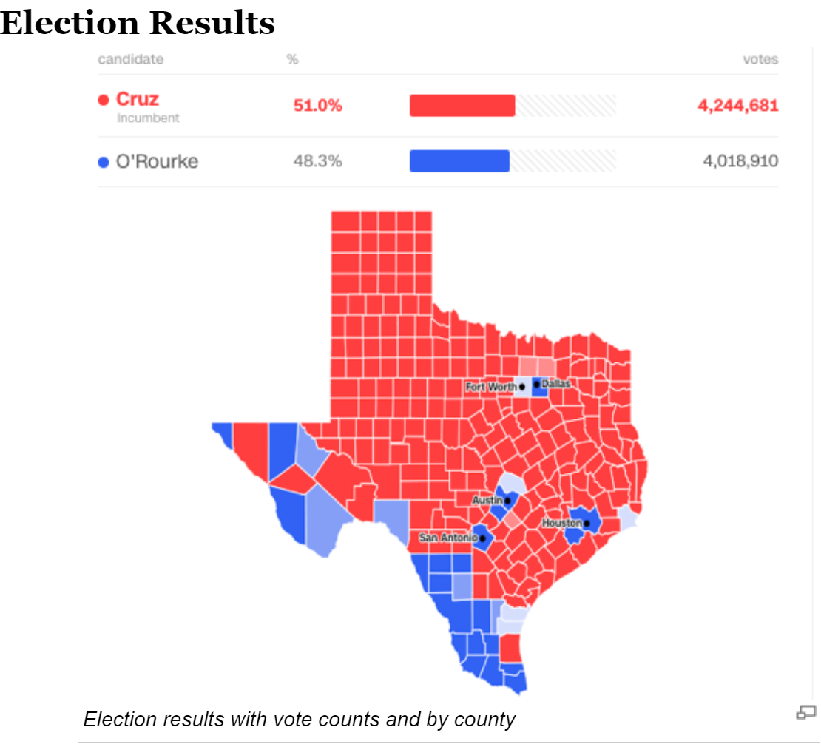
The election Result
Ted Cruz the Republican senator defeated Beto O’Rourke, the Democratic challenger.
Enormous national attention
And “underdog” story?
Clear pattern
Source: “Beto O'Rourke vs. Ted Cruz” Retrieved from https://www.diffen.com/difference/Beto_O%27Rourke_vs_Ted_Cruz

Slide 5
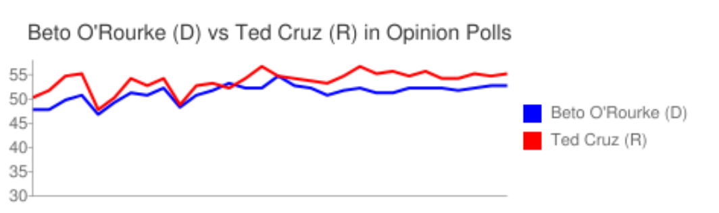
Source: “Beto O'Rourke vs. Ted Cruz” Retrieved from https://www.diffen.com/difference/Beto_O%27Rourke_vs_Ted_Cruz

Slide 6
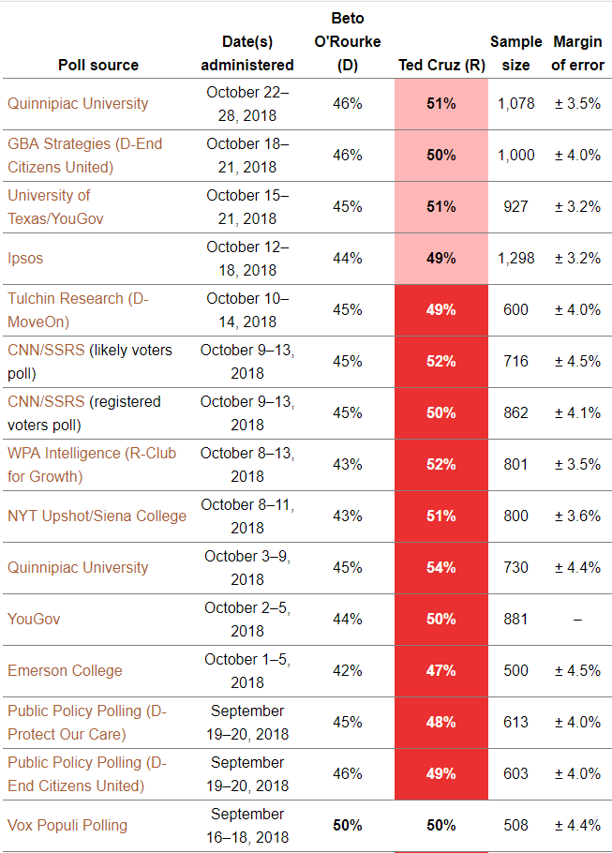
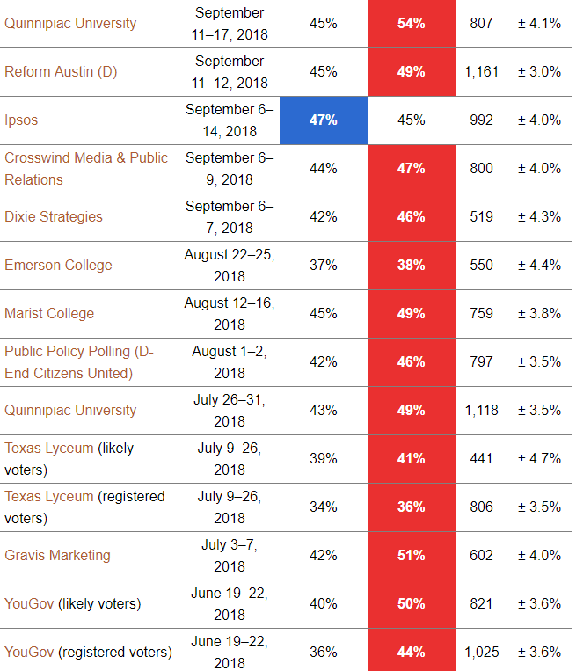
Source: “Beto O'Rourke vs. Ted Cruz” Retrieved from https://www.diffen.com/difference/Beto_O%27Rourke_vs_Ted_Cruz

Slide 7
Data
1.2 million + piece of tweets from 10-21-2018 to 11-06-2018
Early voting period to the end of vote counting (most heated-debate)
Keyword search with web scrawler (“Getoldtweets” package)
Notes:
Which is from the early voting period to the end of vote counting

Slide 8
Data collection methods
API method:
- Clean and Fast
- Time and number restriction (only past 7 days/ limited amount of pieces)
- We don’t really know which part we can get!!
Web scrawling method:
- “Lousy” and slow (take days to scrawl through web pages)
- No time or number restriction
- We still don’t really know which part we can get!!

Slide 9
Data collection methods
Web scrawling method:
- “Getoldtweets” a non-official free packages from Jefferson Henrique
- Problems of incompatibility and updates
- No restriction ≠ Complete

Slide 10
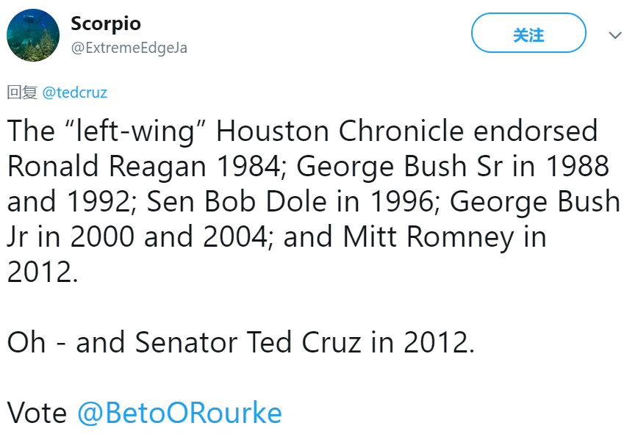
Data Cleansing
Lousy data means a lot of work
Why the raw data is “bad”?
- Problem of separation with signs (“,” “;” …)
(A single tweet could crash the whole dataset)
- In many cases Tweets are not in English:
Hashtags
URL
Images and emotes
Retweets and @s

Slide 11
Problems with Twitter Voting
1. How to count “vote”?
- People or tweets
2. Are tweets truth worthy?
- Spam, bots, disinformation
3. Who are the people?
- We don’t know about the demography
4. Self-selection bias
(Gayo-Avello, 2012)

Slide 12
Two applications of Sentiment analysis
- Lexicon based approach
- Machine learning based approach
Sentence level sentiment analysis with Lexicon based approach:
Classify sentiment represented in individual tweet pieces
Classify overall sentiment represented in daily trends.
Document level sentiment analysis with Naïve Bayes ML approach:
Classify sentiment represented in the whole profile of tweets of a individual
Use hashtag as Prior to perform Naïve Bayes Classification of other individual.

Slide 13
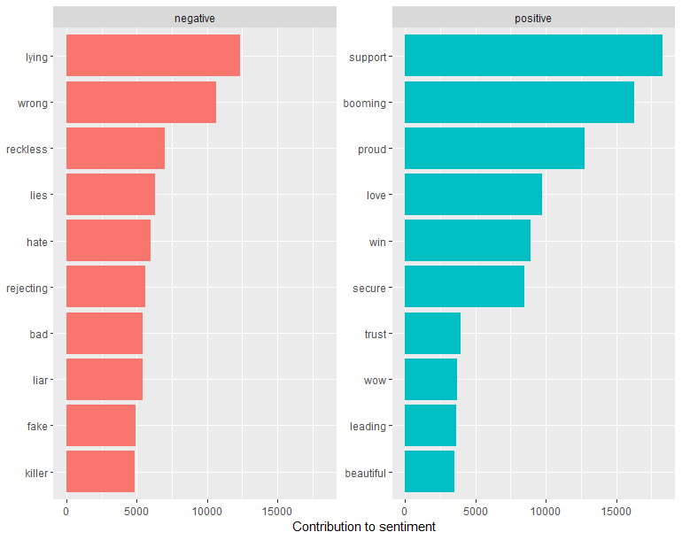
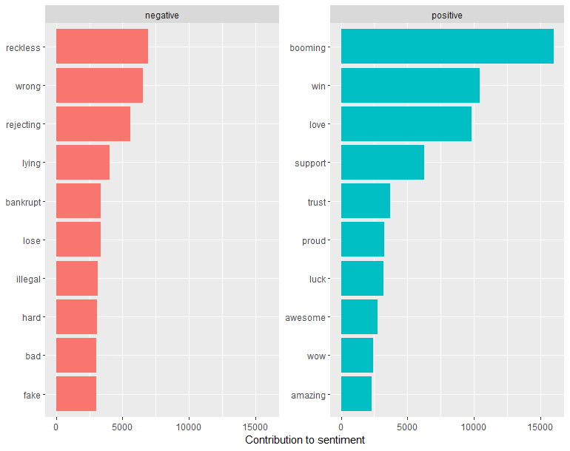
Application of sentiment analysis
Beto O'rourke
Ted Cruz

Slide 14
Q&A

Slide 15
References
Diffen, 2018, Beto O'Rourke vs. Ted Cruz, Retrieved from https://www.diffen.com/difference/Beto_O%27Rourke_vs_Ted_Cruz
Gayo-Avello D (2012). I wanted to predict elections with twitter and all i got was this lousy paper a balanced survey on election prediction using twitter data.

